Slide 1
Sine and Cosine Rule
s.small

Slide 2
The Pythagorean
Theorem
A tool for right
triangle problems only

Slide 3
When do I need to use the Pythagorean Theorem ?
When I know: length of 2 sides
And
Need to know: length of 3rd side

Slide 4
What is the Pythagorean Theorem?
c
a
b
Where a and b are legs and c is the hypotenuse

Slide 5
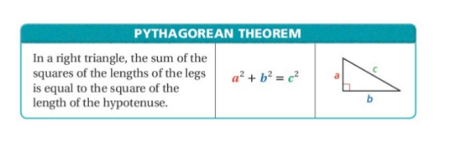
Recall – Pythagoras’ Theorem
You can use Pythagoras’ Theorem to Find the length of the missing side

Slide 6
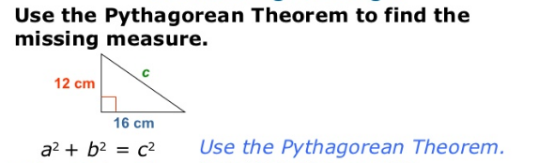

Slide 7
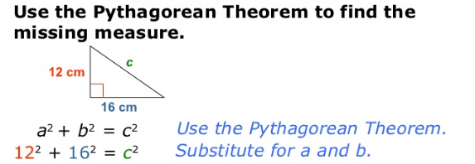

Slide 8
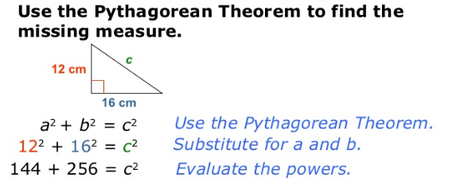

Slide 9
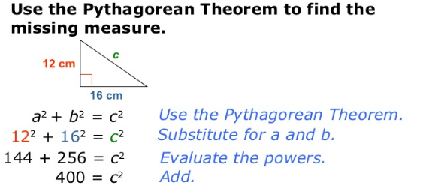

Slide 11
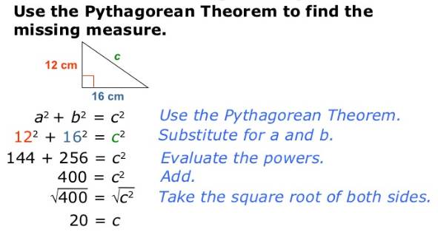

Slide 12
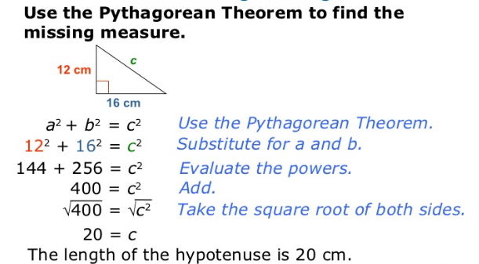

Slide 13
Using a² + b² = c²
a² + b² = c²
15² + 20² = c²
225 + 400 = c²
625 = c²
Looking for length of
the hypotenuse
x
15
20

Slide 14
Using a² + b² = c²
a² + b² = c²
6² + b² = 10²
36 + b² = 100
-36 -36
b² = 64
b = 8
Looking for length of
A leg
10
6
x

Slide 15
Applying the Pythagorean Theorem

Slide 16
A 15 foot ladder leans up against a building. The foot of the ladder is 5 feet from the base of the building. How high up the wall, to the nearest foot does the ladder reach?
Draw a picture:
15
x
5

Slide 17
Solving the problem
a² + b² = c² Write formula
x² + 5² = 15² Substitute in
x² + 25 = 225 Solve for x
- 25 -25
x² = 200
x = 14.142135 Check: How am I
to leave my answer?
The ladder reaches 14 feet up the wall.

Slide 18
Tim rode 8 miles due north, then 3 miles due east. How far, to the nearest mile, is Tim from where he started?
3
Draw a picture:
8
x

Slide 19
Solve the problem
a² + b² = c²
8² + 3² = c²
64 + 9 = c²
73 = c²
Remember: How am I suppose to leave my answer?
C = 8.5440037
Tim is 9 miles from where he started.

Slide 20
Further Applications
The diagonals of a rhombus are 6 cm and 8 cm. What is the length of each side of the rhombus?
Prior Knowledge: What properties does a rhombus have?
The diagonals of a rhombus: bisect each other
The diagonals of a rhombus: are perpendicular
The sides of a rhombus: are congruent

Slide 21
Draw a picture and solve:
A rhombus is really 4 right triangles in disguise!
3
4
x
4
3
a² + b² = c²
3² + 4² = c²
9 + 16 = c²
25 = c²
5 = c
Each side of the rhombus is worth 5 cm.

Slide 22
As seen in the accompanying diagram, a person can travel from NYC to Buffalo by going north 170 miles to Albany and then west 280 miles to Buffalo.
A) If a highway is built to connect NYC and Buffalo, how many miles would be saved on the trip?
B) With gas prices at $3.10 and a vehicle that gets 18 mpg, how much money would be saved roundtrip, if the new highway was traveled instead of the old route?

Slide 23
Find length of new highway
280 miles
a² + b² = c²
280²+170²=c²
107300 m= c²
Buf
Albany
170 miles
???
327.566= c
Did I answer question?
New York City
How many miles would be saved?
Old Distance: 280 + 170 = 450
New Distance: 327.566
Saved Miles: 122.4 or 122 miles

Slide 24
How much money can be saved?
Saved Miles: 122 miles x 2 = 244
Cost to drive one mile (gas):
$3.10 divided by 18. ($0.1722…)
Cost to drive 244miles
$ 0.1722 times 244
Saved: $42.02

Slide 25
Wrapping It UP
The Pythagorean Theorem can be used only on _____triangles.
When should the Pythagorean Theorem be used?
What should be done first when solving a word problem involving the Pythagorean Theorem?
What must be done before writing the answer to a Pythagorean Theorem problem?
Right
When the length of 2 sides are known and the length of 3rd side is needed
Draw and label triangle
Check to see whether the answer should be rounded or not

Slide 26
Ex: 1 Figure out which ratio to use. Find x. Round to the nearest tenth.
20 m
x

Slide 27
Sine and Cosine Rule
s.small

Slide 28
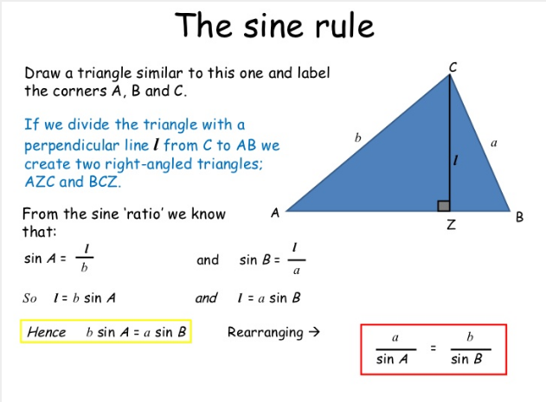

Slide 29
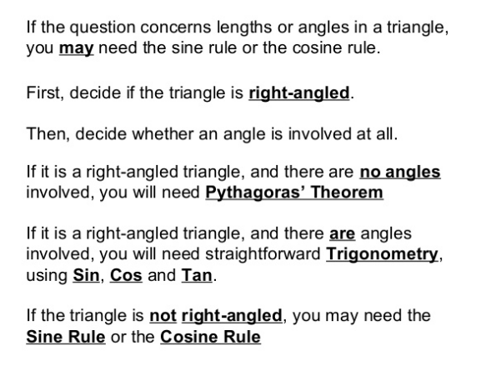

Slide 30
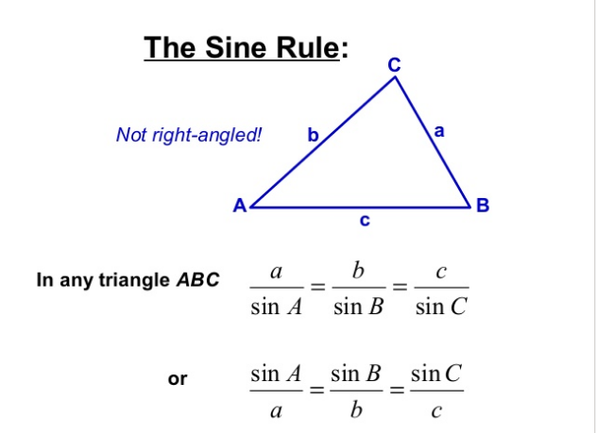

Slide 31
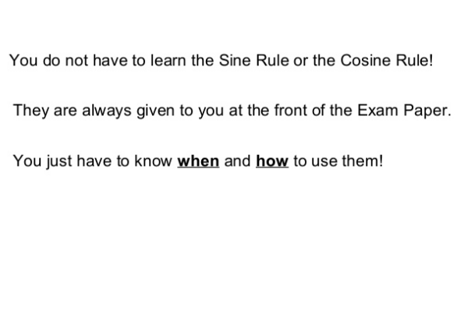

Slide 32
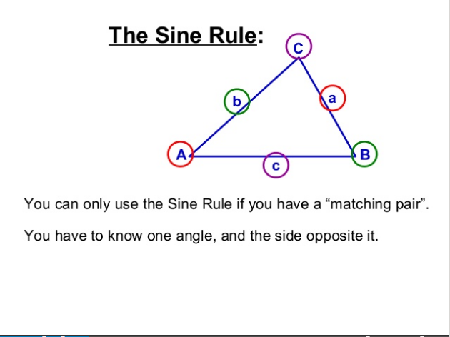

Slide 33
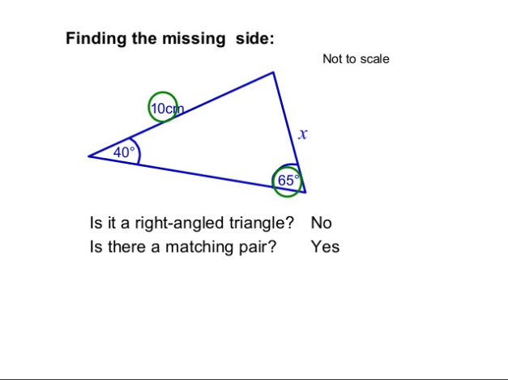

Slide 35
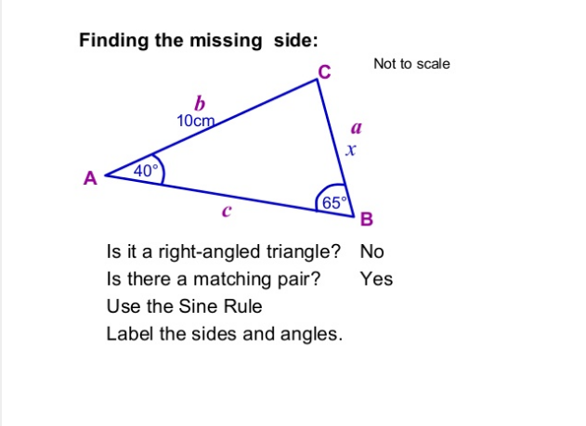

Slide 36
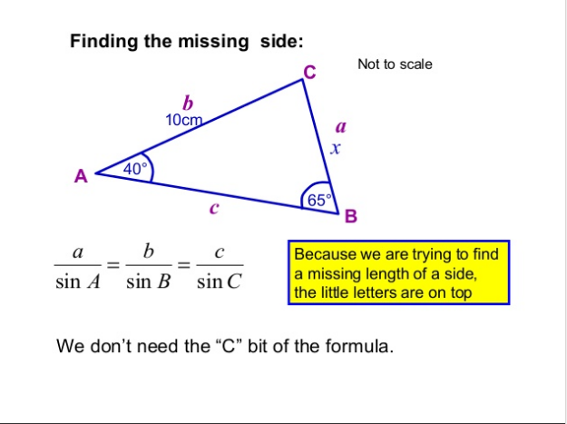

Slide 37
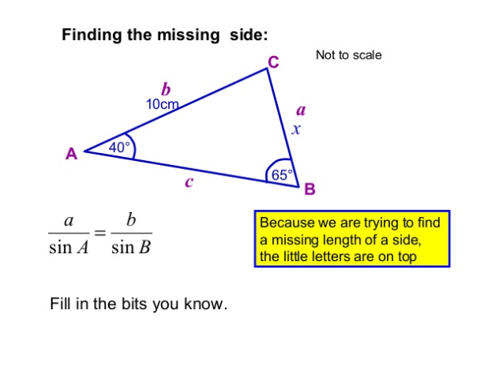

Slide 38
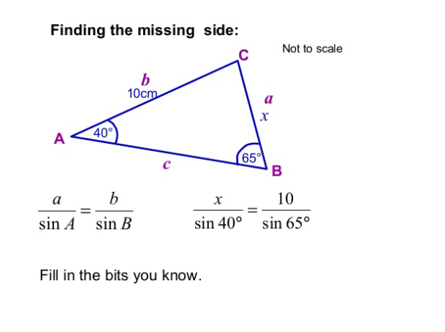

Slide 39
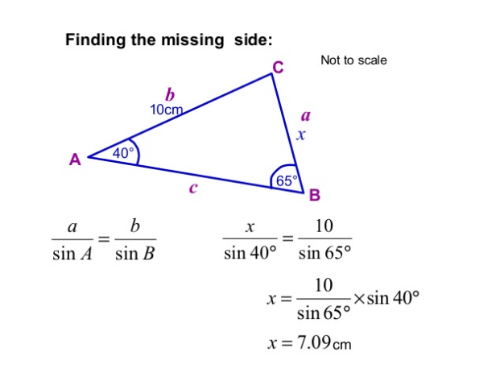

Slide 40
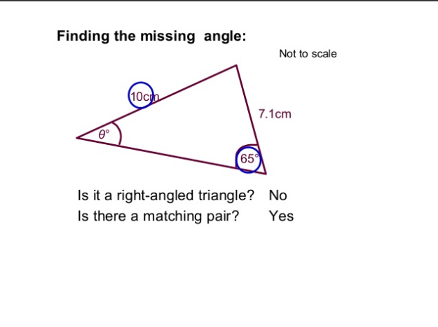

Slide 42
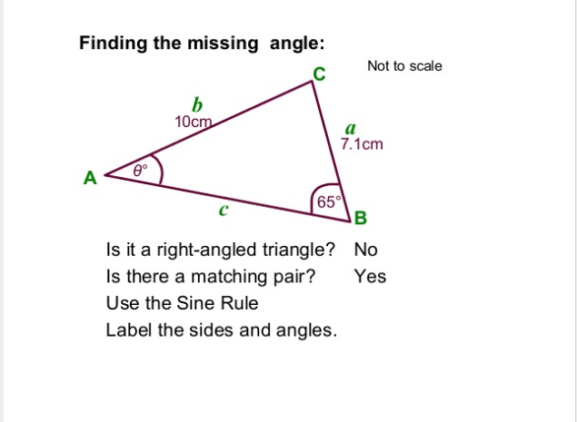

Slide 43
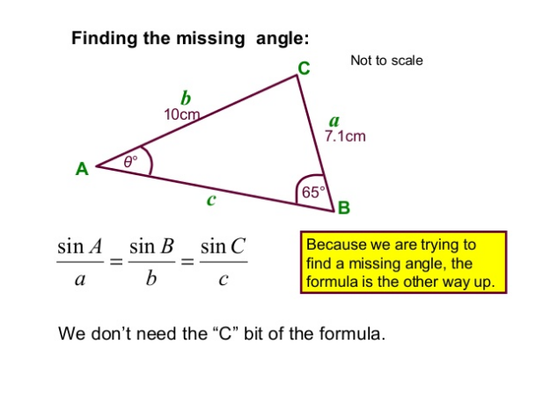

Slide 44
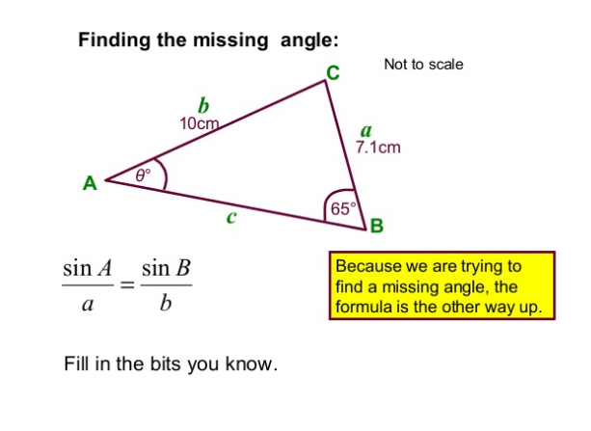

Slide 45
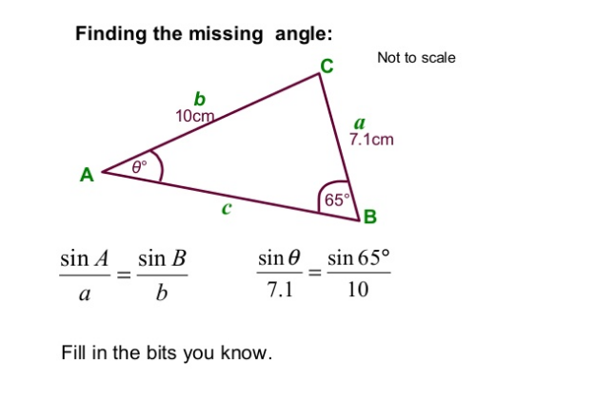

Slide 46
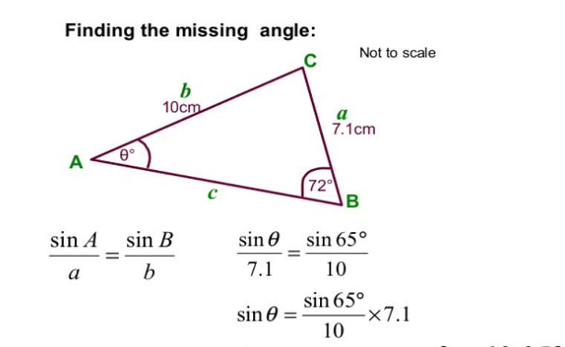

Slide 47
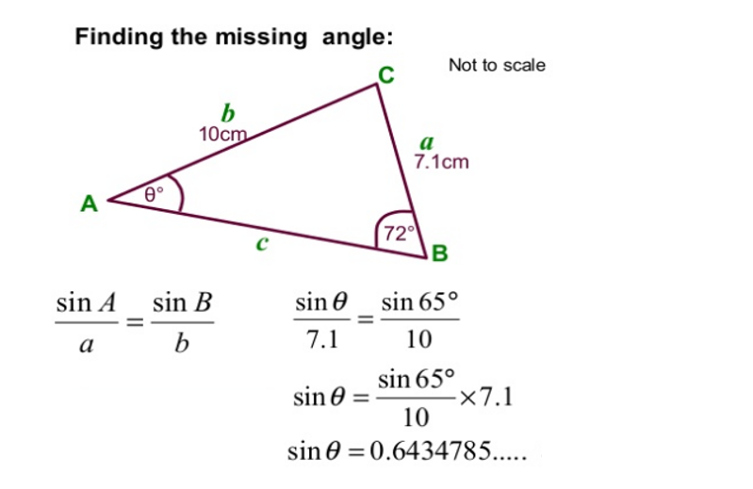

Slide 48
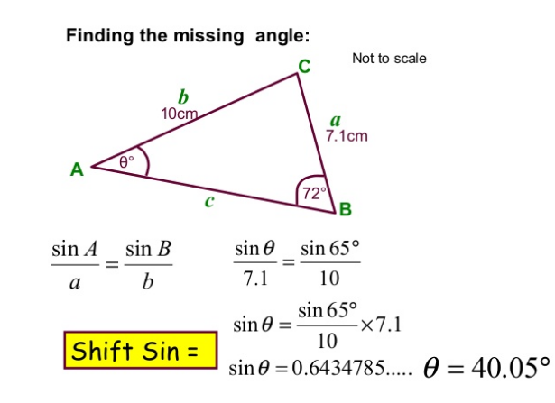

Slide 49
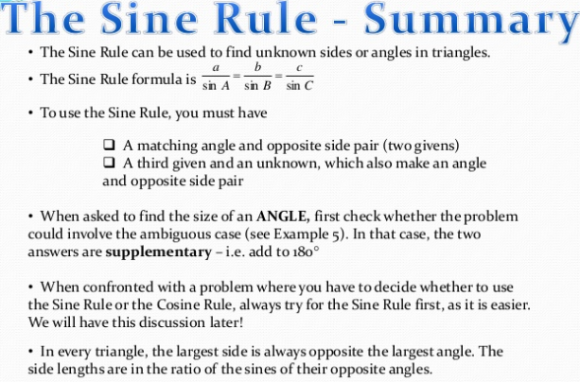

Slide 50
Now Try The worksheet
Question 1 – (a) , (b)
Question 2 – (a) , (b)
Question 3 – (a) , (b)

Slide 51
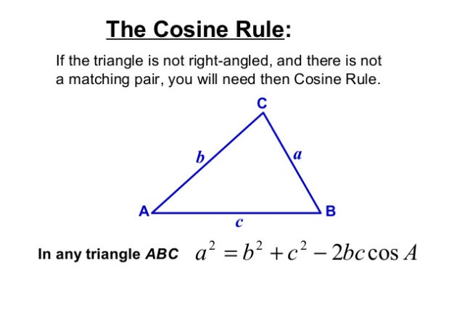

Slide 52
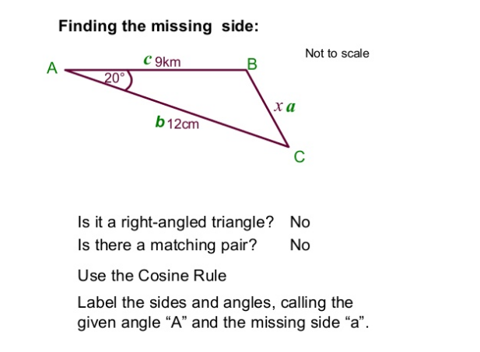

Slide 53
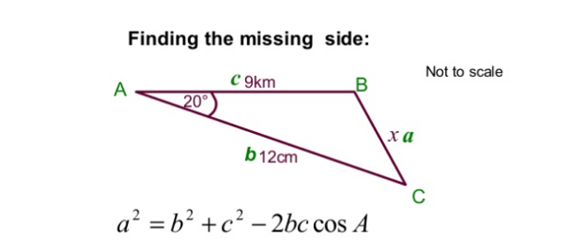

Slide 54
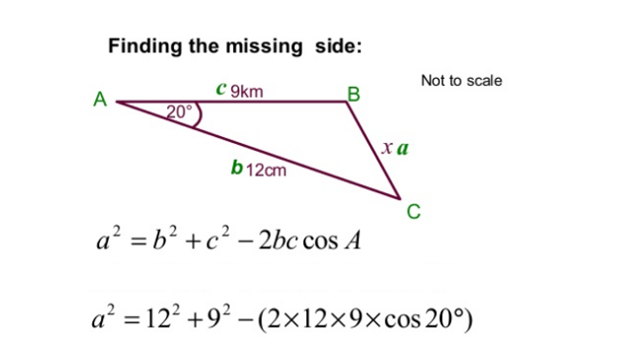

Slide 55
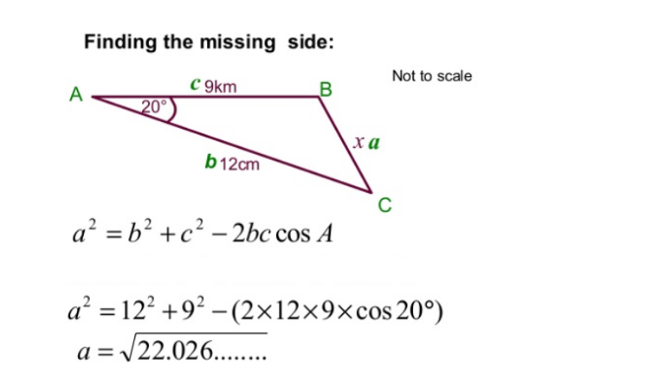

Slide 56
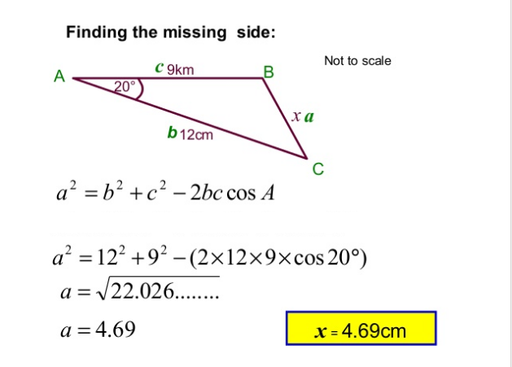

Slide 58
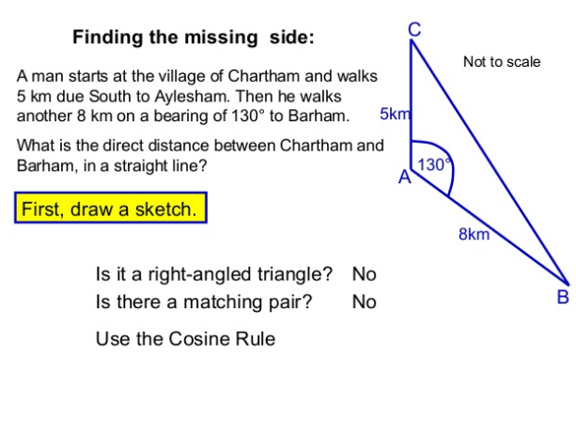

Slide 59
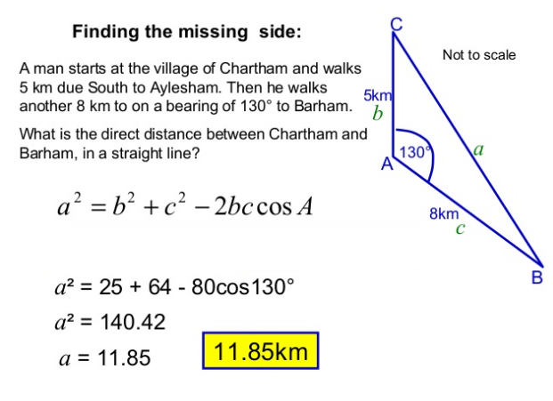

Slide 60
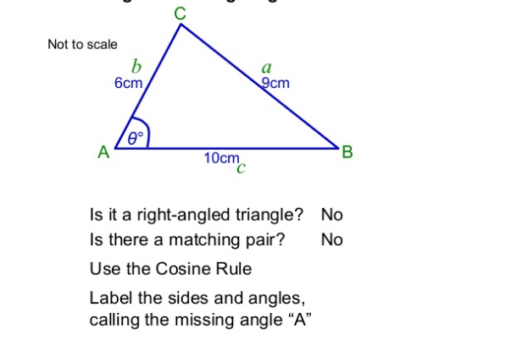

Slide 61
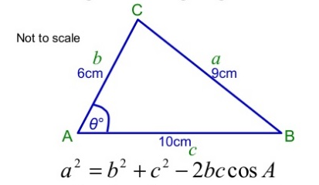

Slide 62
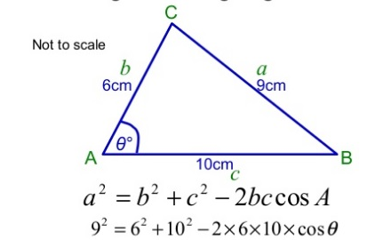

Slide 63
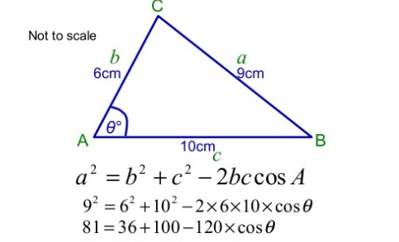

Slide 64
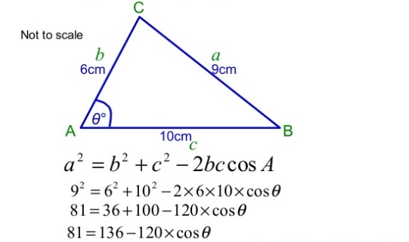

Slide 65
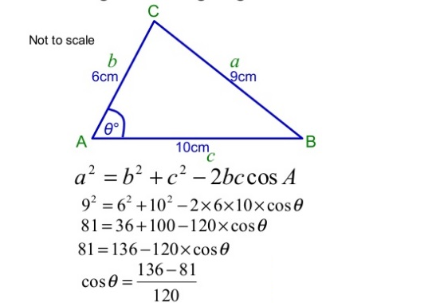

Slide 66
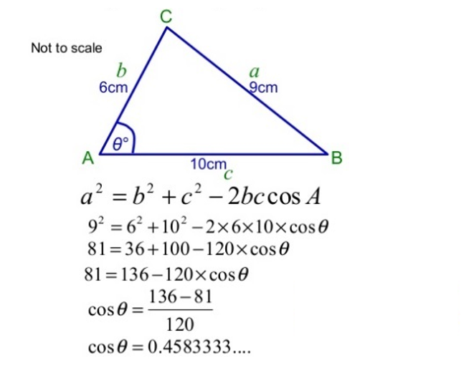

Slide 67
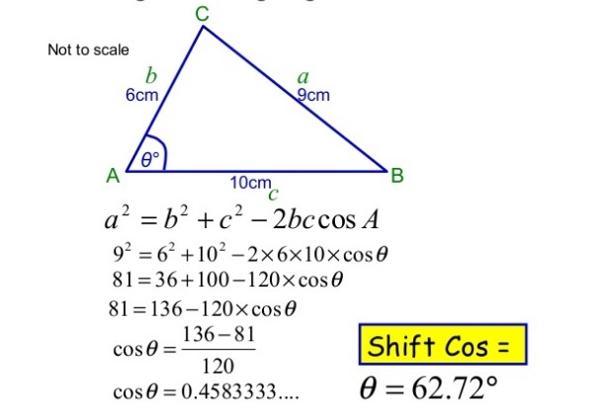

Slide 68
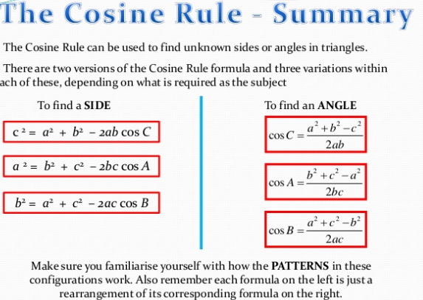

Slide 69
Now Try The worksheet
Question 4 – (a) , (b)
Question 5 – (a) , (b)

Slide 70
