Slide 1
PRIMARY STORAGE

Slide 2
Interesting Fact
1GB can hold 2619 pages (Encyclopaedia Britannica).
What does 50 G.B of storage really mean? It means we can stack 3 piles of single spaced type written pages taller than the Eiffel tower.

Slide 3
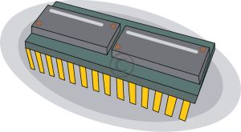
Primary Memory
This is also referred to as Main Memory or Immediate Access Storage.
Types of Memory
Read Only Memory (ROM )
Random Access Memory (RAM)
Both store data in chips.

Slide 4
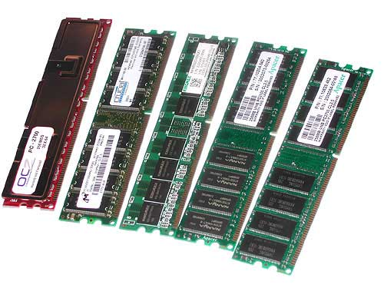
RANDOM ACCESS MEMORY (RAM)
Stores programs and data currently being used by the computer.
RAM is volatile (temporary) memory. The data is lost when the computer is turned off.
Current Examples
DDR, DDR2, DDR3
The size is usually in Megabytes(MB) or Gigabytes(GB)

Slide 5
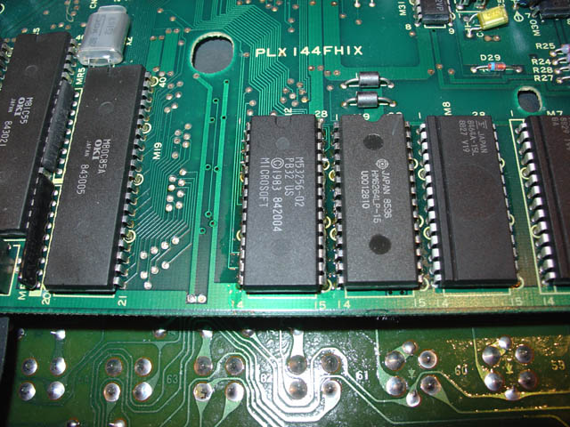
READ ONLY MEMORY
Stores instructions used to start the computer. (E.g BIOS)
This is non-volatile (permanent) memory. This means that data is not lost when the computer is turned off.
Types of ROM
PROM (Progammable Read Only memory) This is a type of ROM programmed with a special machine. Once programmed its content cannot be changed.
EPROM (Erasable Programmable Read Only Memory) The data in this type of PROM can be erased using ultraviolet light.

Slide 6
Bistable Device
These are the foundation of digital electronics.
It is a device that can function in one of only two states.
Examples
A switch (On or Off)
A key on a keyboard. It is either up or down.

Slide 7
Units of Storage
Bit – a unit of storage that has two possible values, 0 and 1
Byte – 8 bits
Kilobyte (KB) – thousand bytes (1 x 10³)
Megabyte (MB) – million bytes (1 x 10⁶)
Gigabyte (GB) – billion bytes (1 x 10⁹)
Terabyte (TB) – trillion byte (1 x 10¹²)
Questions
How many KB in a MB?
Ans : 1000 KB
How many TB in 100GB?
Ans: 0.1 TB

