Slide 1
Propositional Equivalences

Slide 2
What is Logic?
Logic is the study of reasoning - the nature of good (correct) reasoning and of bad (incorrect) reasoning. Its focus is the method or process by which an argument unfolds, not whether any arbitrary statement or series of statements is "true" or accurate. Logicians study and analyze arguments, premises, inferences, propositions, conditional statements, and symbolic forms.
http://www.philosophicalsociety.com/logic.htm#logic-defined

Slide 3
Logic is the formal systematic study of the principles of valid inference and correct reasoning.
It is used in most intellectual activities, but is studied primarily in the disciplines of philosophy, mathematics, semantics, and computer science.

Slide 4
PROPOSITION
A statement that makes a declaration that is either true or false, NOT BOTH

Slide 5
Examples of Propositions
A) Port-of- Spain is the capital of Trinidad and Tobago.
B) Rain is falling
C) 4 + 5 = 12

Slide 6

Are the following propositions? Explain your response.
A) Where are you ?
B) 2$x$ + 3 = 12
C) $x+y+z=14$
D) What is an even number?
E) $\sqrt{2} is rational number?$

Slide 7
Propositions
The truth/ Falsity of a statement is called its “TRUTH VALUE”

Slide 8
Notation
Letters are used to represent propositional statements.
Example: “The rain is falling” can be represented by p.

Slide 9
Notation
When a proposition is true, the truth value is written as “T” OR “1”. However, when it is false it is written as “F” or “0”.

Slide 10
Simple v.s. Compound Statement
Simple = a statement that cannot be decomposed into a separate statement. E.g. “ The sky is blue”
Compound = a statement that can be decomposed into two or more simple statements. The truth value of a compound statement is determined by the truth value of each statement.

Slide 11
Truth table
This is a convenient way of representing the truth value of statements.
Example to follow.

Slide 12

Negation
This is denoted using “~”, as ~p where p is the statement. This is the opposite of a given statement. Other symbols used are “-p” or “$\overline{p}$”

Slide 13
Example
“The rain is falling” = p
“The rain is not falling” = ~p

Slide 14
Truth Table
P | ~P
T
F
P | ~P
T | F
F | T

Slide 15
Connectives
These are used to form compound propositions, or simply to join simple statements to create a compound proposition.

Slide 16

Conjunction (AND)
This is any compound statement formed by joining two simpler statements with “and”. It is denoted by the symbol “$^$”.

Slide 17
Disjunction ( OR )
This is the compound proposition when two simpler statements are connected by “or”. It is denoted by the symbol “v”.
Let’s focus on the two: conjunction and disjunction.

Slide 18
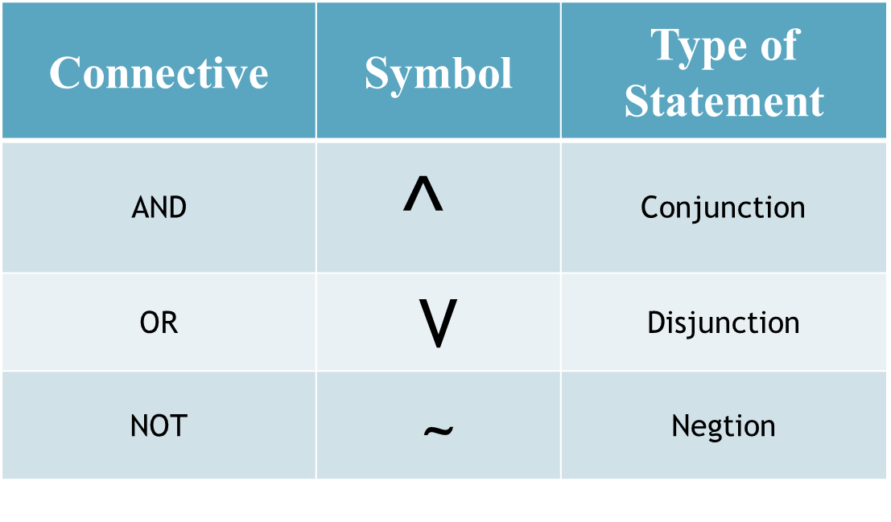
Symbols that are used
Connective | Symbol | Type of Statement
AND | $$^$$ | Conjunction
OR | V | Disjunction
NOT | ~ | Negtion

Slide 19
Truth Table for p ^ q
Recall that the conjunction is the joining of two statements with the word and.
The number of rows in this truth table will be 4. (Since p has 2 values, and q has 2 value.)
Think of a light switch with two switches!!

Slide 20
Truth Table for p ^ q
p | q | p ^ q
T | T
T | F
F | T
F | F

Slide 21
Truth Table for p ^ q
p | q | p ^ q
T | T | T
T | F | F
F | T | F
F | F | F

Slide 22
Truth Table for p ^ q
For p ^ q to be true, then both statements p, q, must be true.
If either statement or if both statements are false, then the conjunction is false.
p | q | p ^ q
T | T | T
T | F | F
F | T | F
F | F | F

Slide 23
How to construct a Truth Table?
A logical statement having n component statements will have 2^{n} rows in its truth table.
If the statement has 2 components or propositions the the number of rows must be
2² = 4 rows.

Slide 24
Activity
Construct a Truth Table with 3 propositions, p, q and r
If a compound statement consists of n individual statements, each represented by a different letter, the number of rows required in the truth table is 2^{n}.

Slide 25
Activity
Construct the truth table for: p ˄ (~ p ˅ ~ q)

Slide 26
Construct the truth table for: p ˄ (~ p ˅ ~ q)
p q | ~ p | ~ q | ~ p ˅ ~ q | p ˄ (~ p ˅ ~ q)
T T | F | F | F
T F | F | T | T
F T | T | F | T
F F | T | T | T

Slide 27
Construct the truth table for: p ˄ (~ p ˅ ~ q)
p q | ~ p | ~ q | ~ p ˅ ~ q | p ˄ (~ p ˅ ~ q)
T T | F | F | F
T F | F | T | T
F T | T | F | T
F F | T | T | T

Slide 28
p q | ~ p | ~ q | ~ p ˅ ~ q | p ˄ (~ p ˅ ~ q)
T T | F | F | F | F
T F | F | T | T | T
F T | T | F | T | F
F F | T | T | T | F

Slide 29
Exercise – Use a Truth Table to show the following
p ˄ ̴ q
( ̴ p ˄ r) ˅ ( ̴ q ˄ p)

Slide 30
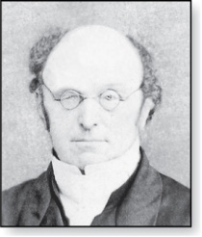
De Morgan’s Laws
~(p ^ q) ≡ ~p v ~q.
Augustus De Morgan
1806-1871
~(p v q) ≡ ~p ^ ~q.
Very useful in constructing proofs
This truth table shows that De Morgan’s Second Law holds

Slide 31
De Morgan’s Laws
Augustus De Morgan
1806-1871
p | q | ~p
T | T | F
T | F | F
F | T | T
F | F | T

Slide 32
De Morgan’s Laws
Augustus De Morgan
1806-1871
p | q | ~p | ~q
T | T | F | F
T | F | F | T
F | T | T | F
F | F | T | T

Slide 33
De Morgan’s Laws
Augustus De Morgan
1806-1871
p | q | ~p | ~q | (p^q)
T | T | F | F | T
T | F | F | T | F
F | T | T | F | F
F | F | T | T | F

Slide 34
De Morgan’s Laws
Augustus De Morgan
1806-1871
p | q | ~p | ~q | (p^q) | ~(p ^q)
T | T | F | F | T | F
T | F | F | T | F | T
F | T | T | F | F | T
F | F | T | T | F | T

Slide 35
De Morgan’s Laws
Augustus De Morgan
1806-1871
p | q | ~p | ~q | (p^q) | ~(p ^q) | ~pV~q
T | T | F | F | T | F | F
T | F | F | T | F | T | T
F | T | T | F | F | T | T
F | F | T | T | F | T | T

Slide 36

Conditional Statements
Statement where one proposition implies the other proposition.
The symbol used is “ $→$”.

Slide 37

Conditional Statement
Given two propositional statements p and q if p implies q we would write that as p $→$ q.
p $→$ q means If p then q.
p is called the hypothesis/ antecedent (cause)
q is called the conclusion / consequent (effect)

Slide 38
Truth Table for p → q
Recall that conditional is a compound statement of the form “if p then q”.
Think of a conditional as a promise.
If I don’t keep my promise, in other words q is false, then the conditional is false if the premise is true.
If I keep my promise, that is q is true, and the premise is true, then the conditional is true.
When the premise is false (i.e. p is false), then there was no promise. Hence by default the conditional is true.

Slide 39
Truth Table for p → q
p | q | p → q
T | T | T
T | F | F
F | T | T
F | F | T

Slide 40
“If you participate in class, then you will get extra points."
When the antecedent is true and the consequent is true, p → q is true.
If you participate in class (true) and you get extra points (true) then,
The teacher's statement is true.
When the antecedent is true and the consequent is false, p → q is false.
If you participate in class (true) and you do not get extra points (false), then,
The teacher’s statement is false.

Slide 41
“If you participate in class, then you will get extra points."
If the antecedent is false, then p → q is automatically true.
If you do not participate in class (false), the truth of the teacher's statement cannot be judged.
The teacher did not state what would happen if you did NOT participate in class. Therefore, the statement has to be “true”.
If you do not participate in class (false), then you get extra points.
If you do not participate in class (false), then you do not get extra points.
The teacher’s statement is true in both cases.

Slide 42
Conditional Statements
Converse
Inverse
Contrapositive

Slide 43
Converse, Inverse, and Contrapositive
Conditional Statement
p → q
If p, then q
Converse
q → p
If q, then p
If not p, then not q
Inverse
̴ p → ̴ q
Contrapositive
If not q, then not p
̴ q → ̴ p

Slide 44
Contrapositive
The contrapositive states that if the conclusion is false then the hypothesis is false. i.e. the contrapositive of p → q looks like :
  (~q) → (~p)
  Draw the Truth Table for (~q) → (~p)

Slide 45
Truth Table for ~q →~p
p | q | ~p | ~q | ~q → ~p
T | T
T | F
F | T
F | F

Slide 46
Inverse
This states that if p is false then q is false.
In other words give the proposition p → q the inverse would be (~p) → (~q).
Work out Truth table for the Inverse compound statement above.

Slide 47
Converse
This states the reverse of the conditional statement.
I.e. if we have the proposition p → q, then its converse would be q → p.
Work out the truth table for the compound statement above.

Slide 48
Equivalent Propositions
Two propositions are equivalent if they always have the same truth value.
This is determined by the output column of the truth table.
We write this as p≡q (or p⇔q)

Slide 49
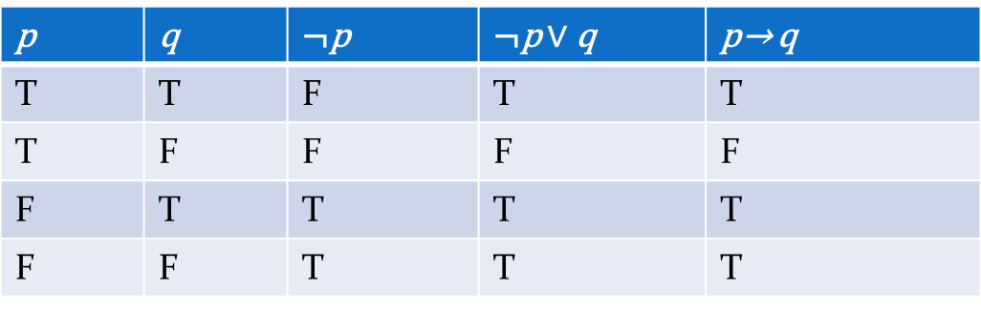
Equivalent Propositions
One way to determine equivalence is to use truth tables
Example: show that ¬p ∨q is equivalent to p → q.

Slide 50
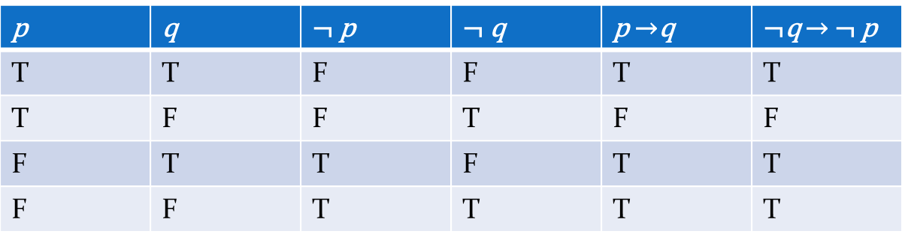
Equivalent Propositions
Example: Show using truth tables that that implication is equivalent to its contrapositive
Solution:

Slide 51
Show Non-Equivalence
Example: Show using truth tables that neither the converse nor inverse of an implication are equivalent to the implication.
Solution:
p | q | ¬ p | ¬ q | p →q | ¬ p →¬ q | q → p
T | T | F | F | T | T | T
T | F | F | T | F | T | T
F | T | T | F | T | F | F
F | F | T | T | T | T | T

Slide 52

Biconditional Statements
These are statements where both propositions imply each other Also looke at as “if and only if”
$↔$ using this symbol for biconditional.

Slide 53

Biconditional Statements
Example
If, I have two propositions p and q the proposition “p if and only if q” is denoted as
p $↔$ q or can be written as p → q ^ q → p.

Slide 54
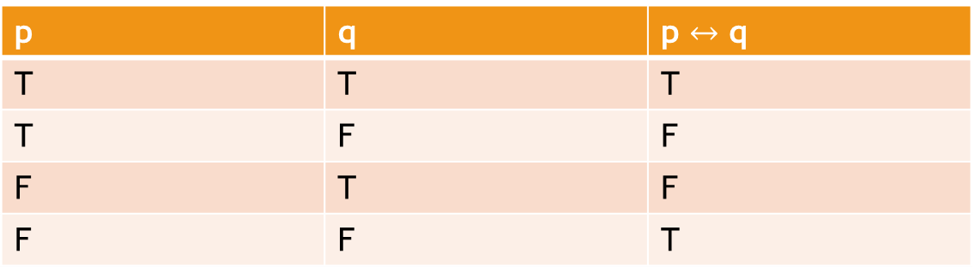
Truth Table
p | q | p $↔$ q
T | T | T
T | F | F
F | T | F
F | F | T

Slide 55
Exercise
Page 17 Ex 23

Slide 56
Tautologies, Contradictions, and Contingencies
A tautology is a proposition that is always true.
  Example: p ∨¬p
A contradiction is a proposition that is always false.
  Example: p ∧¬p
A contingency is a compound proposition that is neither a tautology nor a contradiction
P | ¬p | p ∨¬p | p ∧¬p
T | F | T | F
F | T | T | F

Slide 57
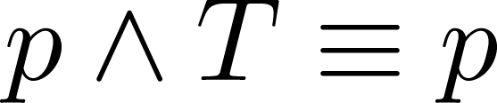
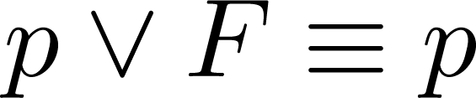
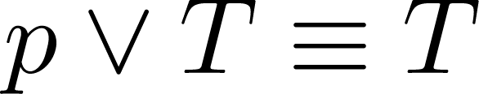
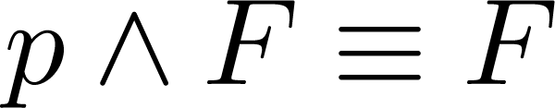
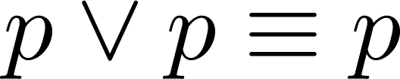
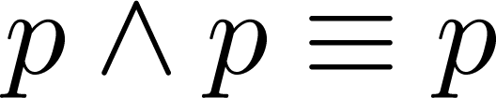
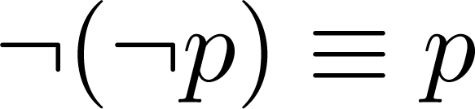
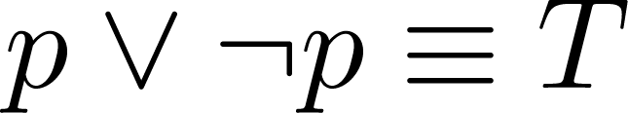
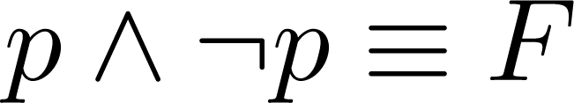
Key Logical Equivalences
Identity Laws: ,
Domination Laws: ,
Idempotent laws: ,
Double Negation Law:
Negation Laws: ,

Slide 58
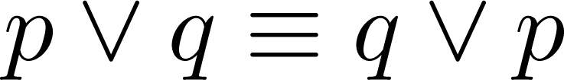
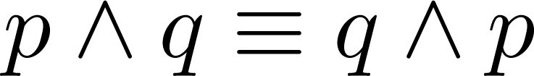
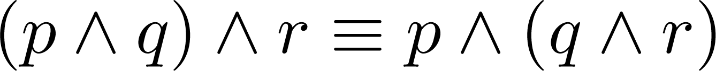
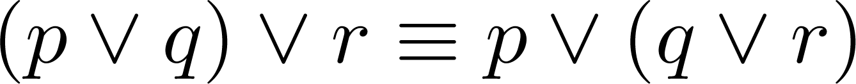
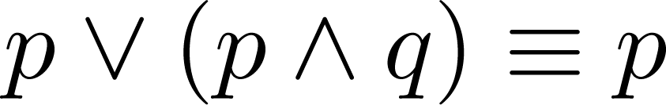
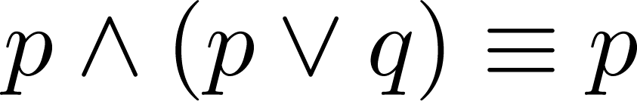
Key Logical Equivalences (cont)
Commutative Laws: ,
Associative Laws:
Distributive Laws:
Absorption Laws:

Slide 59
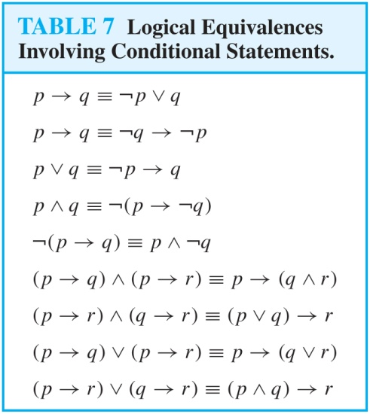
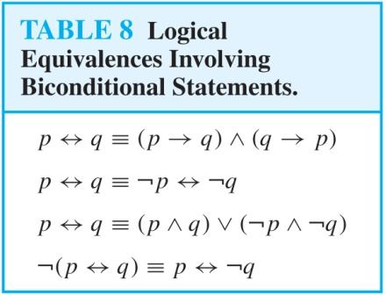
More Logical Equivalences

Slide 60
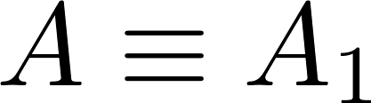
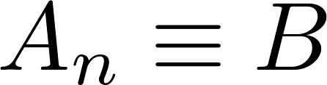
Equivalence Proofs
Instead of using truth tables, we can show equivalence by developing a series of logically equivalent statements.
To prove that A ≡B we produce a series of equivalences leading from A to B.
Each step follows one of the established equivalences (laws)
Each A_{i} can be an arbitrarily complex compound proposition.

Slide 61
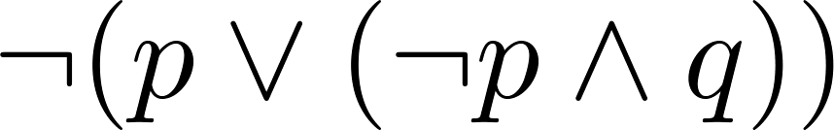
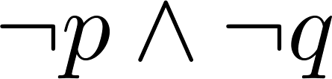
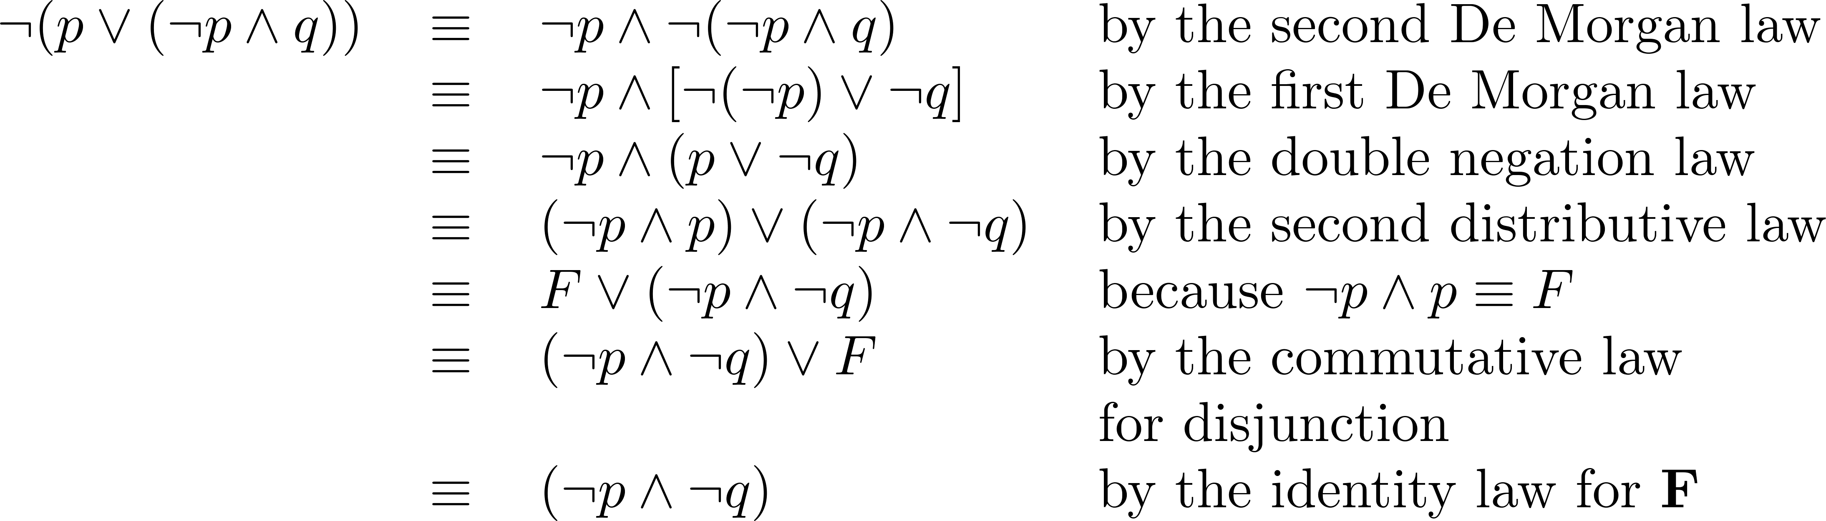
Equivalence Proofs
Example: Show that is logically equivalent to
Solution:

Slide 63
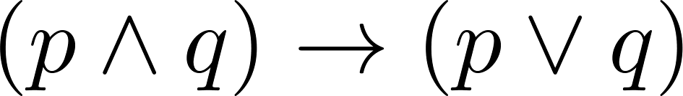
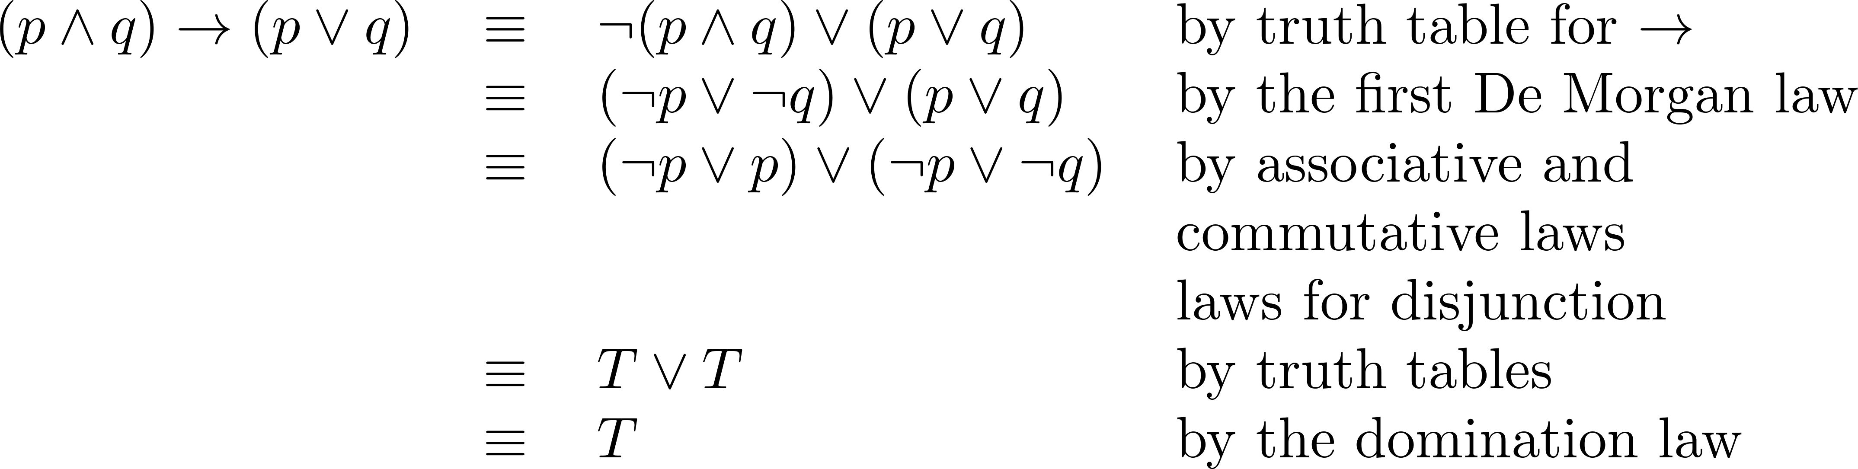
Equivalence Proofs
Example: Show that
is a tautology.
Solution:

