Slide 1
Internet and Communications Technologies

Slide 2
The rise of the Internet has had a revolutionary effect on society. One way the Internet has transformed society includes the evolution of communication technology that eliminates the obstacle of distance from the communication process.
Read more: Internet & Communication Technology | eHow.com http://www.ehow.com/facts_6793539_internet-communication-technology.html#ixzz2GwHBCtkJ

Slide 3
Communication
Data communication, one computer (the sender or transmitter) transmits data to another computer(receiver) over a communication channel or communication link.

Slide 4
Networks
LAN – Local Area Network
MAN - A metropolitan area network (MAN) is a computer network that usually spans a city or a large campus. A MAN usually interconnects a number of LANs.
WAN - A Wide Area Network (WAN) is a network that covers a broad area (i.e., any telecommunications network that links across metropolitan, regional, or national boundaries) using private or public network transports.

Slide 5
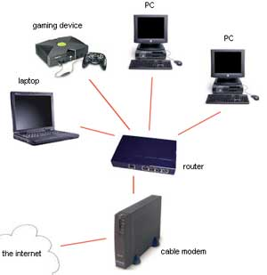
LAN

Slide 6
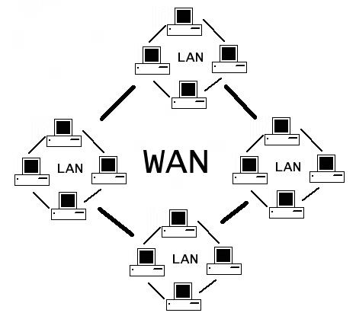
WAN

Slide 7
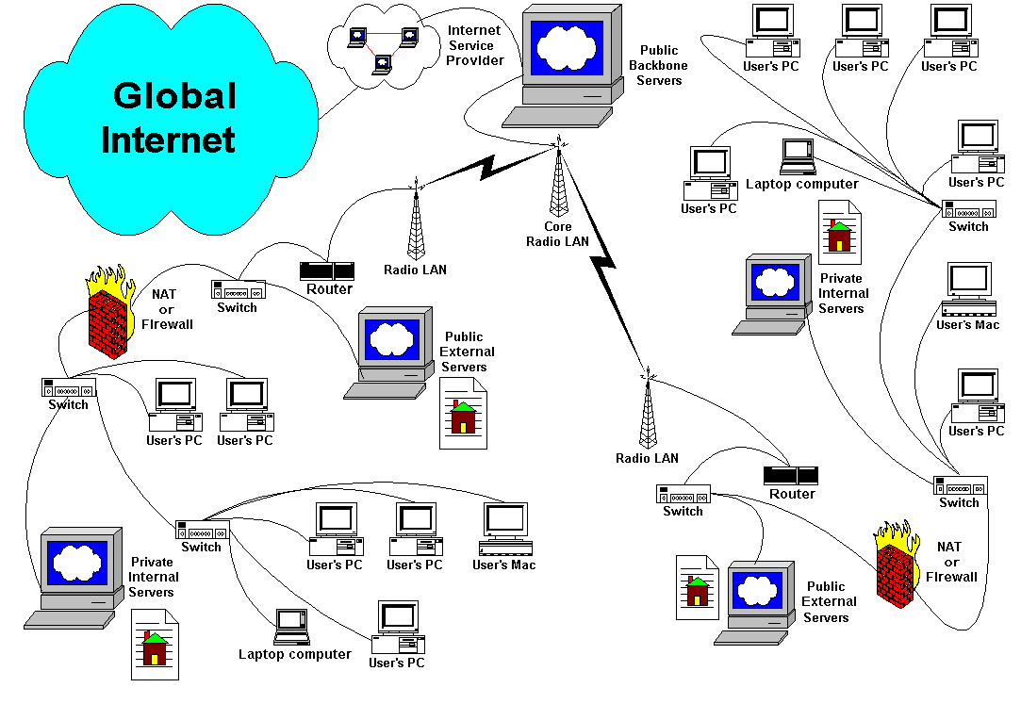
MAN

Slide 8
Types of Transmission Media
Wired Media such as coaxial, Twisted Pair and Fiber-Optic cables.

Slide 9
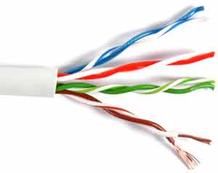
WiredMedia
Twisted Pair

Slide 10
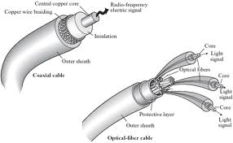
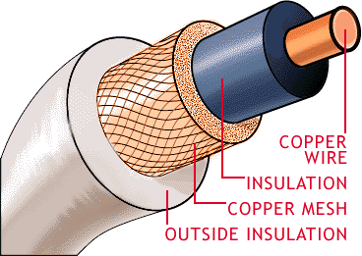
Wired Media
Coaxial Cables

Slide 11
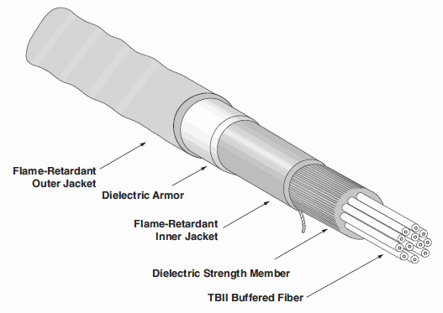
Wired Media
Fiber Optic Cables

Slide 12
Types of Transmission
Wired Media
Wireless Media
These include; Satellite, microwave and infrared.

Slide 13
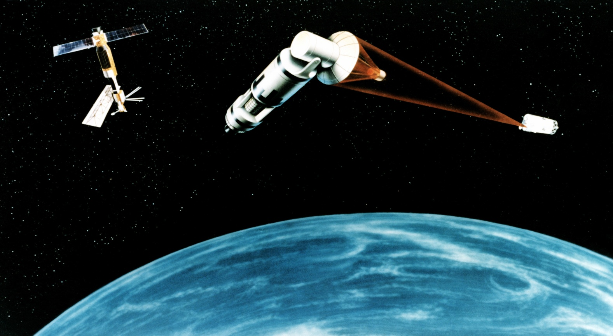
Wireless Media
Satellite

Slide 14
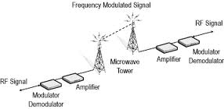
Wireless Media
Microwave

Slide 15
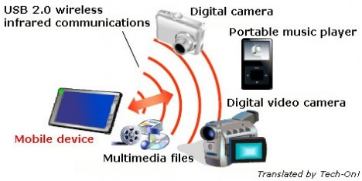
Wireless Media
Infrared

