Slide 1
What does it mean to transpose?
TRANSPOSITION

Slide 2
1. To reverse or transfer the order or place of; interchange. See Synonyms at reverse. 2. Mathematics To move (a term) from one side of an algebraic equation to the other side, reversing its sign to maintain equality.

Slide 3
Transposition
To reverse or Transfer the order or place of or interchange;
Mathematics to move a term from one side of an algebraic equation to the other. Reversing the sign is to maintain the equality.

Slide 4
Transpose for “m”
2 (m + 1) = 8

Slide 5
Opposite on the other side
Addition -> Subtraction
Multiplication -> Division
Squaring -> Square Root
Positive -> Negative

Slide 6
Transpose so that “y” is the subject
" 8 + y = 9 "

Slide 7
Transpose to m
2m = 8

Slide 8
QUESTIONS TO DO
-8 + y = 10
-2m = -10
5 – y = 6
2m + 3 = 7

Slide 9
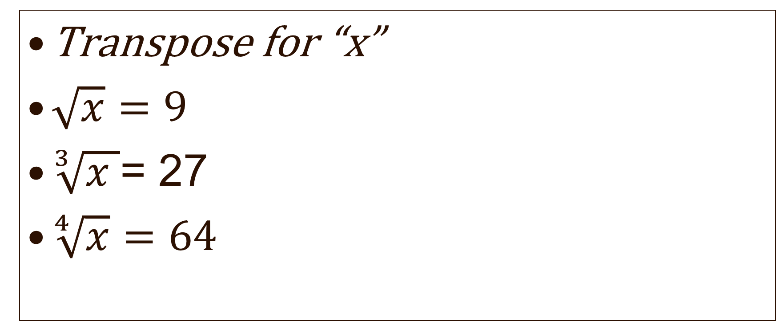
Trick Question
Transpose for “x”
$\sqrt{x}=9$
$\sqrt[3]{x }$= 27
$\sqrt[4]{x}=64$

Slide 10
Transpose for “m”
2 (m + 1) = 8

Slide 11

$2\left(x+2\right)=x+8$

Slide 12

$6\left(x+ 3\right)=18$

Slide 13
$x+y=5$ , Transpose for x
$x+y=5, Transpose for y$

Slide 14
$3\left(m+n\right)=6, Make m the suject$
$3\left(x+2 \right)+4x=37, Transpose for x$
$5\left(2t+1 \right)+3\left(t+2\right)=39 Find the value of t$

Slide 15
THINKING TIME
$\sqrt{\frac{4x+3}{2}}=a$

Slide 16
$Interest=\frac{Price x Rate x Time}{100},$
$Make Time the subject$
Make Rate the subject
Make Price the subject

Slide 17
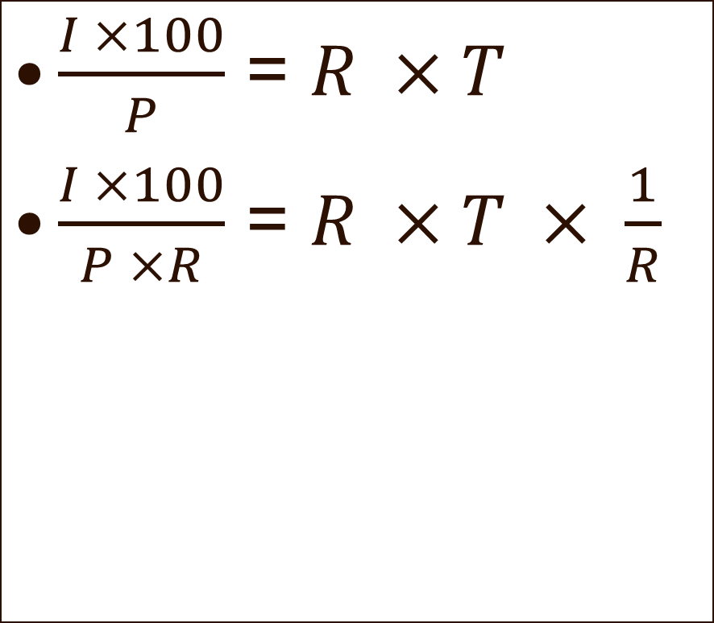
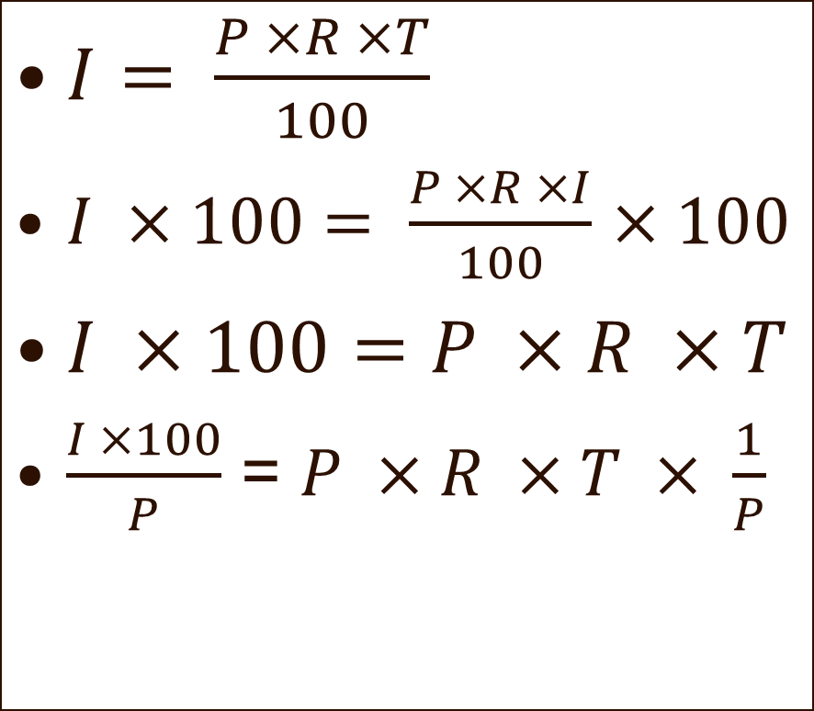
I, P, R, T , 100
$I= \frac{P ×R ×T}{100}$
$I ×100= \frac{P ×R ×I}{100}$ $×100$
$I ×100=P ×R ×T$
$\frac{I ×100}{P}$ = $P ×R ×T × \frac{1}{P}$
$\frac{I ×100}{P}$ = $R ×T$
$\frac{I ×100}{P ×R}$ = $R ×T × \frac{1}{R}$

Slide 18
$p= \sqrt{q}, Make q the subject.$
$p= \sqrt{a+b}, to make b the subject$
$p= \sqrt{a+b}, to make a the subject$

Slide 19
$p= \sqrt{q}, Make q the subject.$
${\left(p\right)}^{2}= {\left(\sqrt{q}\right)}^{2}$ - Squaring both sides of the equation
$p^{2}=q$

Slide 20
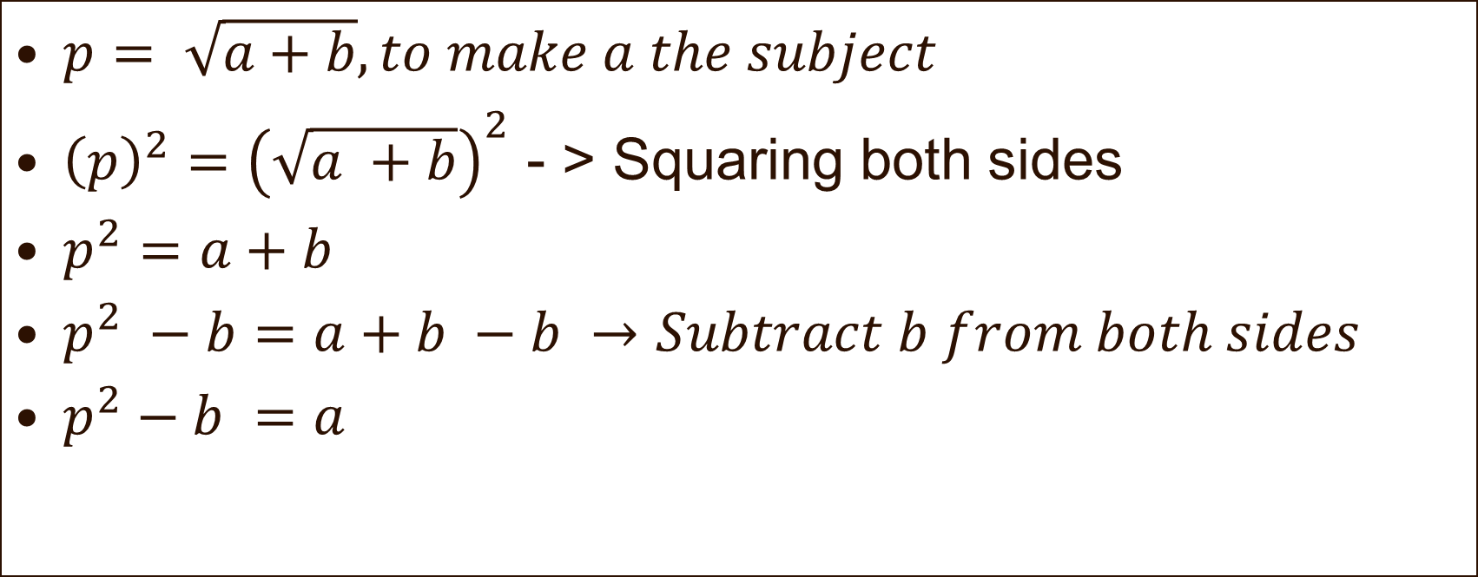
$p= \sqrt{a+b}, to make a the subject$
${\left(p\right)}^{2}={\left(\sqrt{a +b}\right)}^{2}$ - > Squaring both sides
$p^{2}=a+b$
$p^{2} −b=a+b −b →Subtract b from both sides$
$p^{2}−b =a$

Slide 21
Transpose for “l”
$P=2w+2l$

Slide 22
$P=2w+2l$
$P −2w=2w+2l −2w$ - > Subtract w from both sides
$P −2w=2l$
$\frac{P −2w}{2}=2l × \frac{1}{2}$ -> Dividing by 2 on both sides
$\frac{P −2W}{2}=l$

Slide 23

Transpose for “y”
$−3\left(y−4\right)+2=7−(y+1)$
$\left(−3×y\right)+\left(−3 × 2\right)=7\left(−1×y\right)+\left(−1×1\right)$
-3y – 6 = 7 – y -1

Slide 24
-3y – 6 = 7 – y -1
-3y -6 + y = 7 – y – 1 + y
-3 y + y – 6 = 7 – 1

Slide 25
-3 y + y – 6 = 7 – 1
-2y – 6 = 7 – 1
-2y – 6 + 6 = 6 + 6
-2y = 12

Slide 26

-2y = 12
$\frac{−2 y }{−2}$ = $\frac{12}{\begin{aligned}−2 \\ \end{aligned}}$
y = -6

Slide 27
$v= \frac{k}{\sqrt{x}}$ , Make x the subject of the equation.

Slide 28

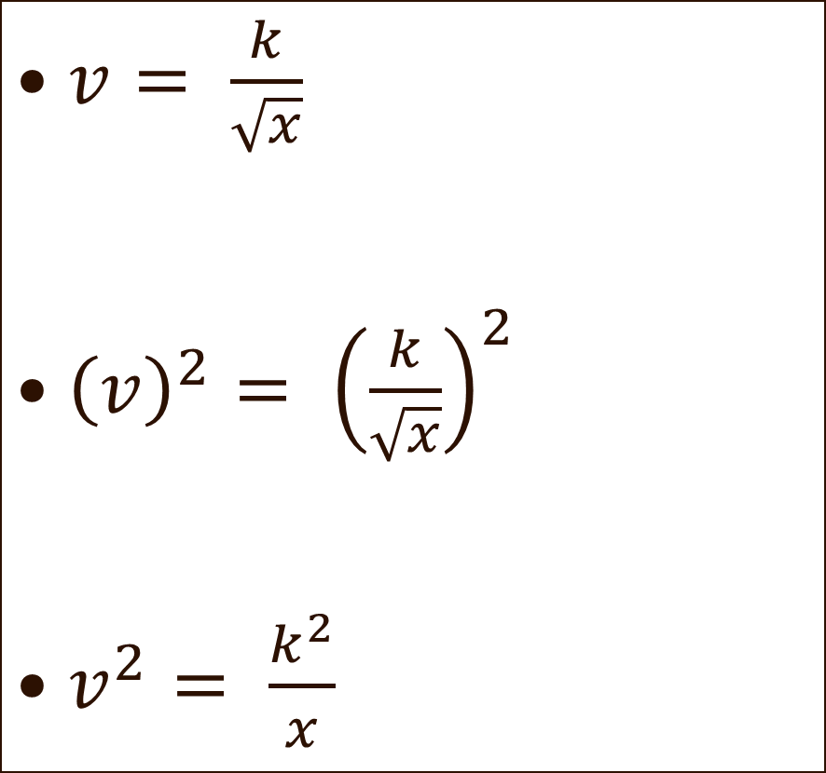
$v= \frac{k}{\sqrt{x}}$
${\left(v\right)}^{2}= {\left(\frac{k}{\sqrt{x}}\right)}^{2}$
$v^{2}= \frac{k^{2}}{x}$
$x × v^{2} = \frac{k^{2}}{x} × x$

Slide 29
$i= \frac{3}{x}$
$i ×x= \frac{3}{x} ×x$
$ix=3$

Slide 30

Make “x” the subject
$\frac{4}{3x}=s$
$\frac{4}{3x } ×3x =s ×3x$
$$4=3xs$$

Slide 31

$\frac{4}{3x}+3 =m$
$\frac{4}{3x }+3 −3=m −3$
$\frac{4}{3x}=m −3$

Slide 32

$\frac{4}{3x}×3x=3x (m −3)$
$4=3mx −9x$
4 = x( 3m – 9) $\frac{4}{3m −9}=x$

Slide 33
$R=Q{(1+i)}^{3}$, Transpose for “i”.

Slide 34
Thinking Time
$m= \frac{x}{2}\text{, }$
$\frac{1+x}{2}\text{ = 10, }$
$y= \frac{1}{x+1}$

Slide 35
Thinking Time
$\frac{\sqrt{2x+3}}{2}=a$

Slide 36

Thinking Time
$$\frac{4\left(x^{2}+3\right)}{2}=a$$

Slide 37
Thinking Time
$$\frac{4−x^{2}}{2}=a$$

Slide 38
$T=\left(2π\right)\sqrt{\frac{1}{g}}$

Slide 39
Double Instances of the same variable
This is were you have two occurrence of “x”
You are to make “x” the subject.
Using factorization.
Using the principles of Transposition earnt from before.

Slide 40
Make “x” the subject
$\frac{3x+5}{7−x}=y$

Slide 41

Review
$30 −3x=6$
$s − \frac{x}{3}=m$
$\frac{a −px}{2}=b$

Slide 42

$\frac{12}{3x}=a$
$\frac{a }{x+5}=6$
$\frac{a}{3x+m }=6$

Slide 43
$\frac{a+b}{{2x}^{2}}=5$

Slide 44
TWO Xs ?????
$5x −a=3x −b$
Bring the “Xs” on one side together.
Factorise or Simplify to get one “x” term.
Then Proceed to make “X” the subject.

Slide 45
$6x+a=4x −b$

Slide 46

$$\frac{x+5}{3 −x}=a$$

Slide 47

$k= \frac{3x+3}{x+1}$
$p −xg= \frac{mx}{r}$

Slide 48
$\frac{3x+4}{x }=b$

Slide 49
$\frac{2x+2}{x+3}=b$

Slide 50
$\frac{2\left(x −4\right)}{x+4}=b$

