Slide 1
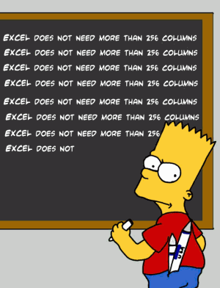
SPREADSHEET

Slide 2
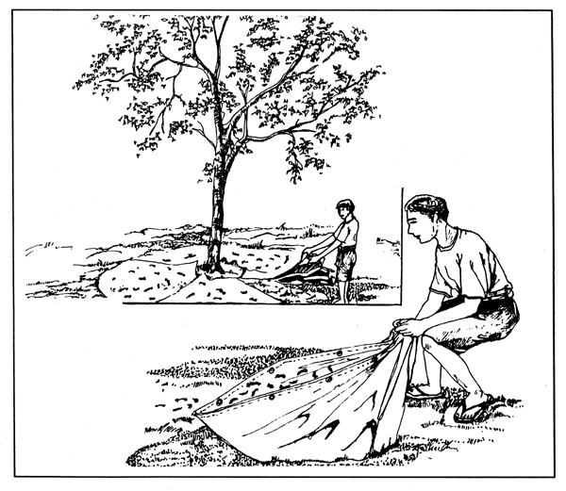
What is a spreadsheet ?

Slide 3
Spreadsheet
A spreadsheet is a tool that is used for analyzing, charting and managing data.

