Slide 1
HARDWARE
SPECIFICATIONS

Slide 2
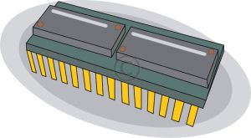
CENTRAL PROCESSING UNIT
The CPU chip is called a microprocessor.
The speed of the CPU is measured in Giga Hertz (GHz). This indicates how powerful it is.
Leading microprocessor manufacturers :
Intel
Advanced Micro Devices (AMD)

Slide 3
Examples
Intel
Intel Pentium
Intel Celeron
Intel Core Duo (Intel Core 2 Duo)
AMD
AMD Athlon (AMD Athlon X2)
AMD Sempron
AMD Phenom

Slide 4
Why is my computer so slow?

Slide 5
Memory
This usually refers to the type of RAM
Types
SDRAM (Synchronous DRAM)
RDRAM (Rambus DRAM) DDR (Double Data Rate SDRAM)
Speeds
PC 2100 533Mhz (DDR)
PC 3200 400Mhz (DDR2)

Slide 6
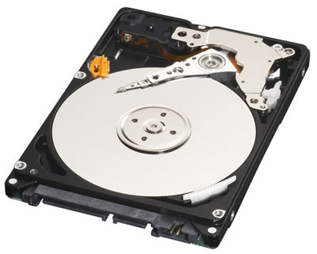
Hard Drive
This is where the data (pictures, music, documents )is stored.
Size
Usually in the range of Gigabytes(GB)
Eg. 80GB, 120GB, 320GB, 500GB
Speed
Typically two speeds:
7200rpm (desktops)
5400rpm (laptops)

Slide 7
Activity

