Slide 1
Algebra
MULTIPLYING , Factorizing

Slide 2
Home Work or Paw Work
Dog
HomeWork
Paw
Floor

Slide 3
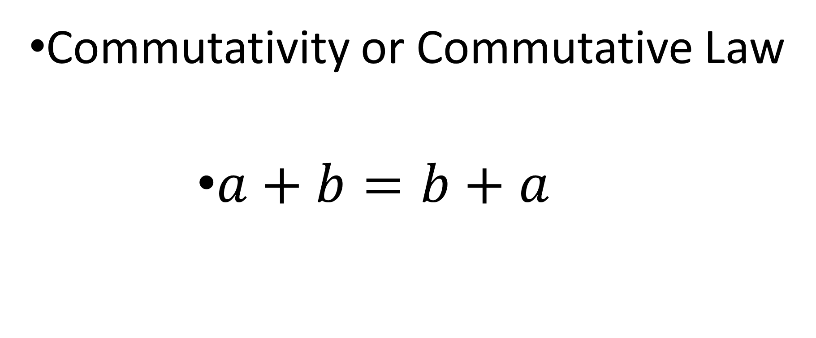
Some Laws of Algebra
Commutativity or Commutative Law
$a+b=b+a$

Slide 4

Law of Associativity or Associative Law
$$a+ \left(b+c\right)= \left(a+b \right)+c$$
$$a\left(bc\right)=\left(ab\right)c$$

Slide 5

Law of Distributivity – or Distributive Law
$$a\left(b+c\right)=ab+ac$$
$$a\left( b−c \right)=ab −ac$$
$$\frac{a+b }{c }= \frac{a}{c }+ \frac{b}{c}$$

Slide 6
Re-Write Using Commutative Property
x + y
t + 10

Slide 7

Re-Write Using Commutative Property
$$\left(x+y \right)+z$$
$$x\left(yz\right)$$
$$7\left(ab\right)$$

Slide 8
Rewrite using the distributive property.
e ( g + h )
f ( j - s )
5 ( a + b )
3 ( x + 6 )

Slide 9

$$2(5x −1 )$$
$$\frac{x+8}{8 }$$

Slide 10

Remove the brackets
$$−\left(3+x \right)$$
$$−(5x+7)$$
$$−2 (4x+8 )$$

Slide 11
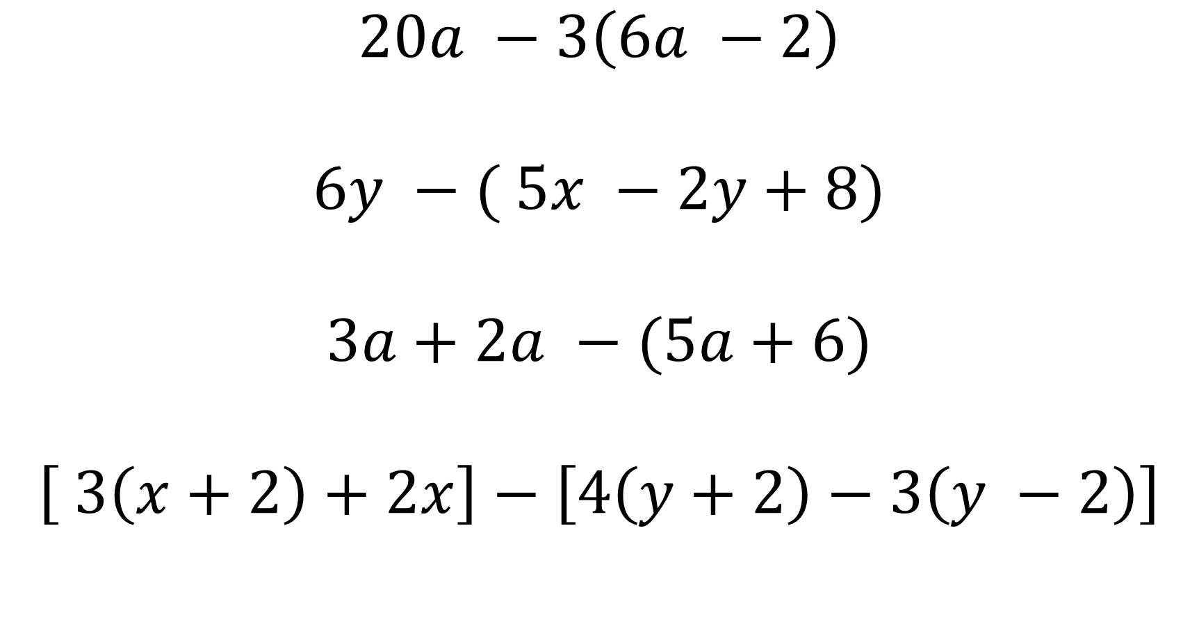
$$20a −3\left(6a −2\right)$$
$$6y −( 5x −2y+8)$$
$$3a+2a −(5a+6)$$
$$\left[ 3\left(x+2\right)+2x\right]−\left[4\left(y+2\right)−3\left(y −2\right)\right]$$

Slide 12
Equations: Addition Principle
x + 3 = - 12
m - 5 = - 2
- 8 + y = 19

Slide 13

Solve for x.
9x - 5 = 13
3x + 12 = 24
$\frac{5x}{7 }=8$

Slide 14
Algebra Word problems
Jennifer has $26 less than triple the savings of Matthew. Matthew has
saved $81. How much has Jennifer saved?

Slide 15
Algebra Word problems
Harold has typed 14 more pages than Rebecca. Together they have typed a total of 138 pages. How many pages have each of them typed?

Slide 16
Algebra Word problems
The sum of 3 consecutive whole numbers is 72. What are the 3 numbers?

Slide 17
Factoring
Factoring (called "Factorising" in the UK) is the process of finding the factors:

Slide 18
Factoring in Algebra
Factoring:
Numbers have Factors:
$2 × 3 = 6$
Factors

Slide 19
Factoring
It is like "splitting" an expression into a multiplication of simpler expressions.

Slide 20

Example: Factor 2y+6
Both 2y and 6 have a common factor of 2:
$$2y is 2×y$$
$$6 is 2 ×3$$

Slide 21
So you can factor the whole expression into:
$$2y+6=2(y+3)$$
So 2y+6 has been "factored into" 2 and y+3

Slide 22
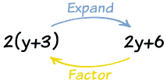

Slide 23
Highest Common Highest (H.C.F.)
Example: factor 3y²+12y
Firstly, 3 and 12 have a common factor of 3.

Slide 24

Example: Factor 3y²+12y
So you could have:
$$3y^{2}+12y=3\left(y^{2}+y\right)$$

Slide 25

Can we do better?
$$3y^{2} and 12y also share the variable y.$$
Together that makes 3y:
$$3y^{2} is 3y ×y$$
$12y is 3y ×4$

Slide 26

$$3y^{2}+12y=3y(y+4)$$

Slide 27
Rewrite by factoring.
$$2b+2c$$
$$7x+4x$$
15s – 11s

Slide 28

Algebra: Simplifying Expressions
$$3x+6x$$
$$8x+4y −5x −7y$$
$$10x −x$$
$$−9x+x$$
$$8x −5x+3+2y −y −1$$

Slide 29
$4x^{3}+2x^{2}+2x$
$2x({2x}^{2}+x+1)$

Slide 30
x³ + x² + x

Slide 31
15a + 12b + 6c

Slide 32
8x² + -18y²

Slide 33
z³ + 4z²

Slide 34
4x² + -4x

Slide 35

$15x^{2}−50x −10$
Simplifying
$15x^{2}−50x −10$
Factor out the Greatest Common Factor (GCF), '5'.
$5\left(−2 −10x+3x^{2}\right)$

Slide 36
10 + -10n + 10n²

Slide 37
18k + 36k² + 9k³

Slide 38
Simplifying
$x^{2} −12x+27=0$
Labelling Quadratic:
$$a=1, b=−12, c=27$$
Finding Factors: $a ×c →1 ×27=27$
(3, 9) , (27, 1) , (-3, -9), ( -27, -1)
Note Factors when summed should get the value of b
-9 + - 3 = -9 – 3 = -12

Slide 39

$x^{2} −12x+27= x^{2} −3x −9x+27$
$x\left(x −3\right) −9(x −3)$ = 0
$\left(x−3\right)\left(x −9\right)=0$
Solving for variable 'x'.
$\left(x−3\right)\left(x −9\right)=0$

Slide 40
Set the factor ($x$ - 3) equal to zero and attempt to solve:
Simplifying, Solve for $"x"$
$$x −3+3=0+3$$
$$x=3$$

Slide 41
Solution
x = {3, 9}

Slide 42
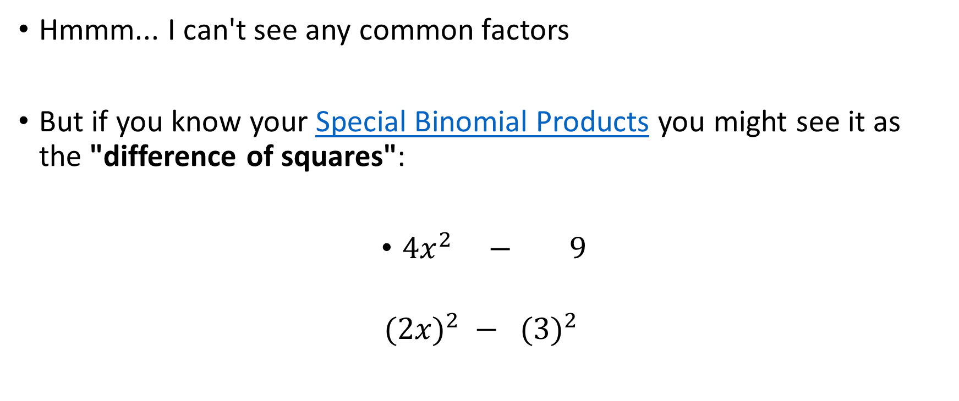
Factor 4x² - 9
Hmmm... I can't see any common factors
But if you know your Special Binomial Products you might see it as the "difference of squares":
$4x^{2} − 9$
$${ (2x)}^{2} − {(3)}^{2}$$

Slide 43
Because 4x² is (2x)², and 9 is (3)²,
so we have:
4x² - 9 = (2x)² - (3)²

Slide 44
And that can be produced by the difference of squares formula:
(a+b)(a-b) = a² - b²
Where a is 2x, and b is 3.

Slide 45
So let us try doing that:
(2x+3)(2x-3) = (2x)² - (3)² = 4x² - 9

Slide 46
So the factors of 4x² - 9 are (2x+3) and (2x-3):
Answer: 4x² - 9 = (2x+3)(2x-3)

Slide 47
Remember these Identities
Here is a list of common "Identities" (including the "difference of squares" used above).
It is worth remembering these, as they can make factoring easier

Slide 48
There are many more like those, but those are the simplest ones.
a² - b² | = | (a+b)(a-b)
a² + 2ab + b² | = | (a+b)(a+b)
a² - 2ab + b² | = | (a-b)(a-b)
a³ + b³ | = | (a+b)(a²-ab+b²)
a³ - b³ | = | (a-b)(a²+ab+b²)
a³+3a²b+3ab²+b³ | = | (a+b)³
a³-3a²b+3ab²-b³ | = | (a-b)³

Slide 49
Solution
(a)
Okay since the first term is x2 we know that the factoring must take the form.
We know that it will take this form because when we multiply the two linear terms the first term must be x2 and the only way to get that to show up is to multiply x by x. Therefore, the first term in each factor must be an x. To finish this we just need to determine the two numbers that need to go in the blank spots.
We can narrow down the possibilities considerably. Upon multiplying the two factors out these two numbers will need to multiply out to get -15. In other words these two numbers must be factors of -15. Here are all the possible ways to factor -15 using only integers.

Slide 50
Now, we can just plug these in one after another and multiply out until we get the correct pair. However, there is another trick that we can use here to help us out. The correct pair of numbers must add to get the coefficient of the x term. So, in this case the third pair of factors will add to “+2” and so that is the pair we are after.
Here is the factored form of the polynomial.
Again, we can always check that we got the correct answer by doing a quick multiplication.

Slide 51
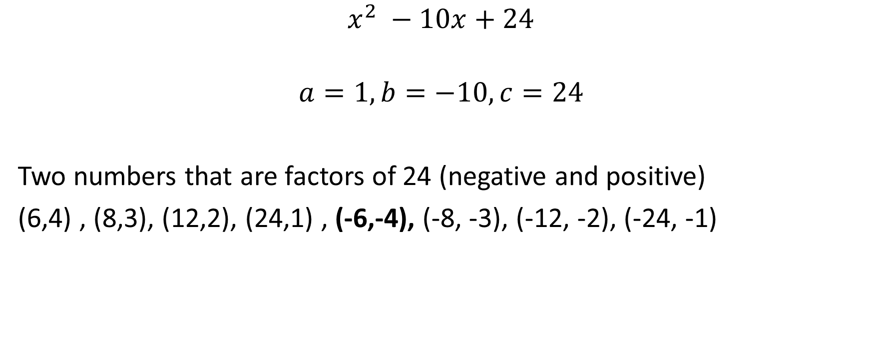
$$x^{2} −10x+24$$
$$a=1, b=−10, c=24$$
Two numbers that are factors of 24 (negative and positive)
(6,4) , (8,3), (12,2), (24,1) , (-6,-4), (-8, -3), (-12, -2), (-24, -1)

Slide 52

$x^{2} −10x+24 =0$
Re-write the Quadratic equation:
$$x^{2} −6x −4x+24=0$$
$x\left(x −6\right)−4 \left(x −6\right) =0$
$$\left(x −6\right)\left( x −4\right)=0$$

